Slide 1
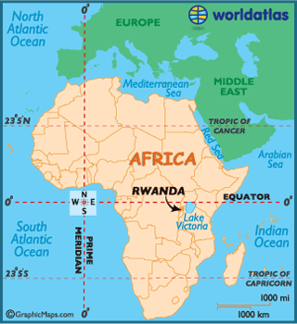
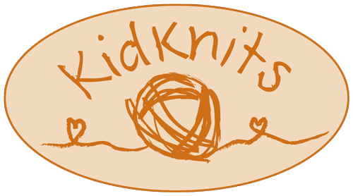
Where in the world…
Rwanda is very near the equator,
which means the climate is very constant year round.

Slide 2
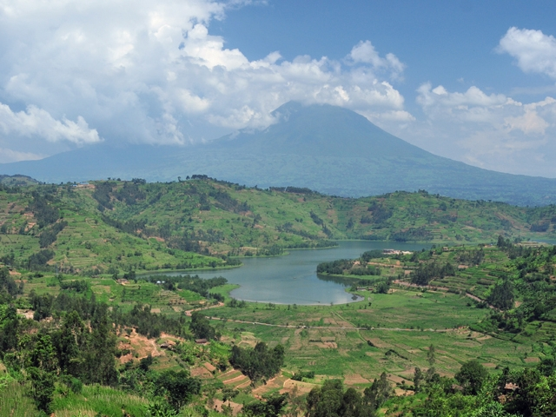
Mountains!
However, most of Rwanda is at very high altitude, which keeps temperatures very comfortable all year.
The difference between the average high temperatures of the hottest and coldest months is only 6°F!

Slide 3
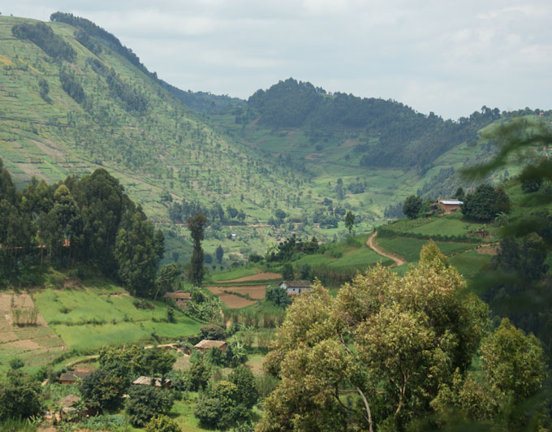
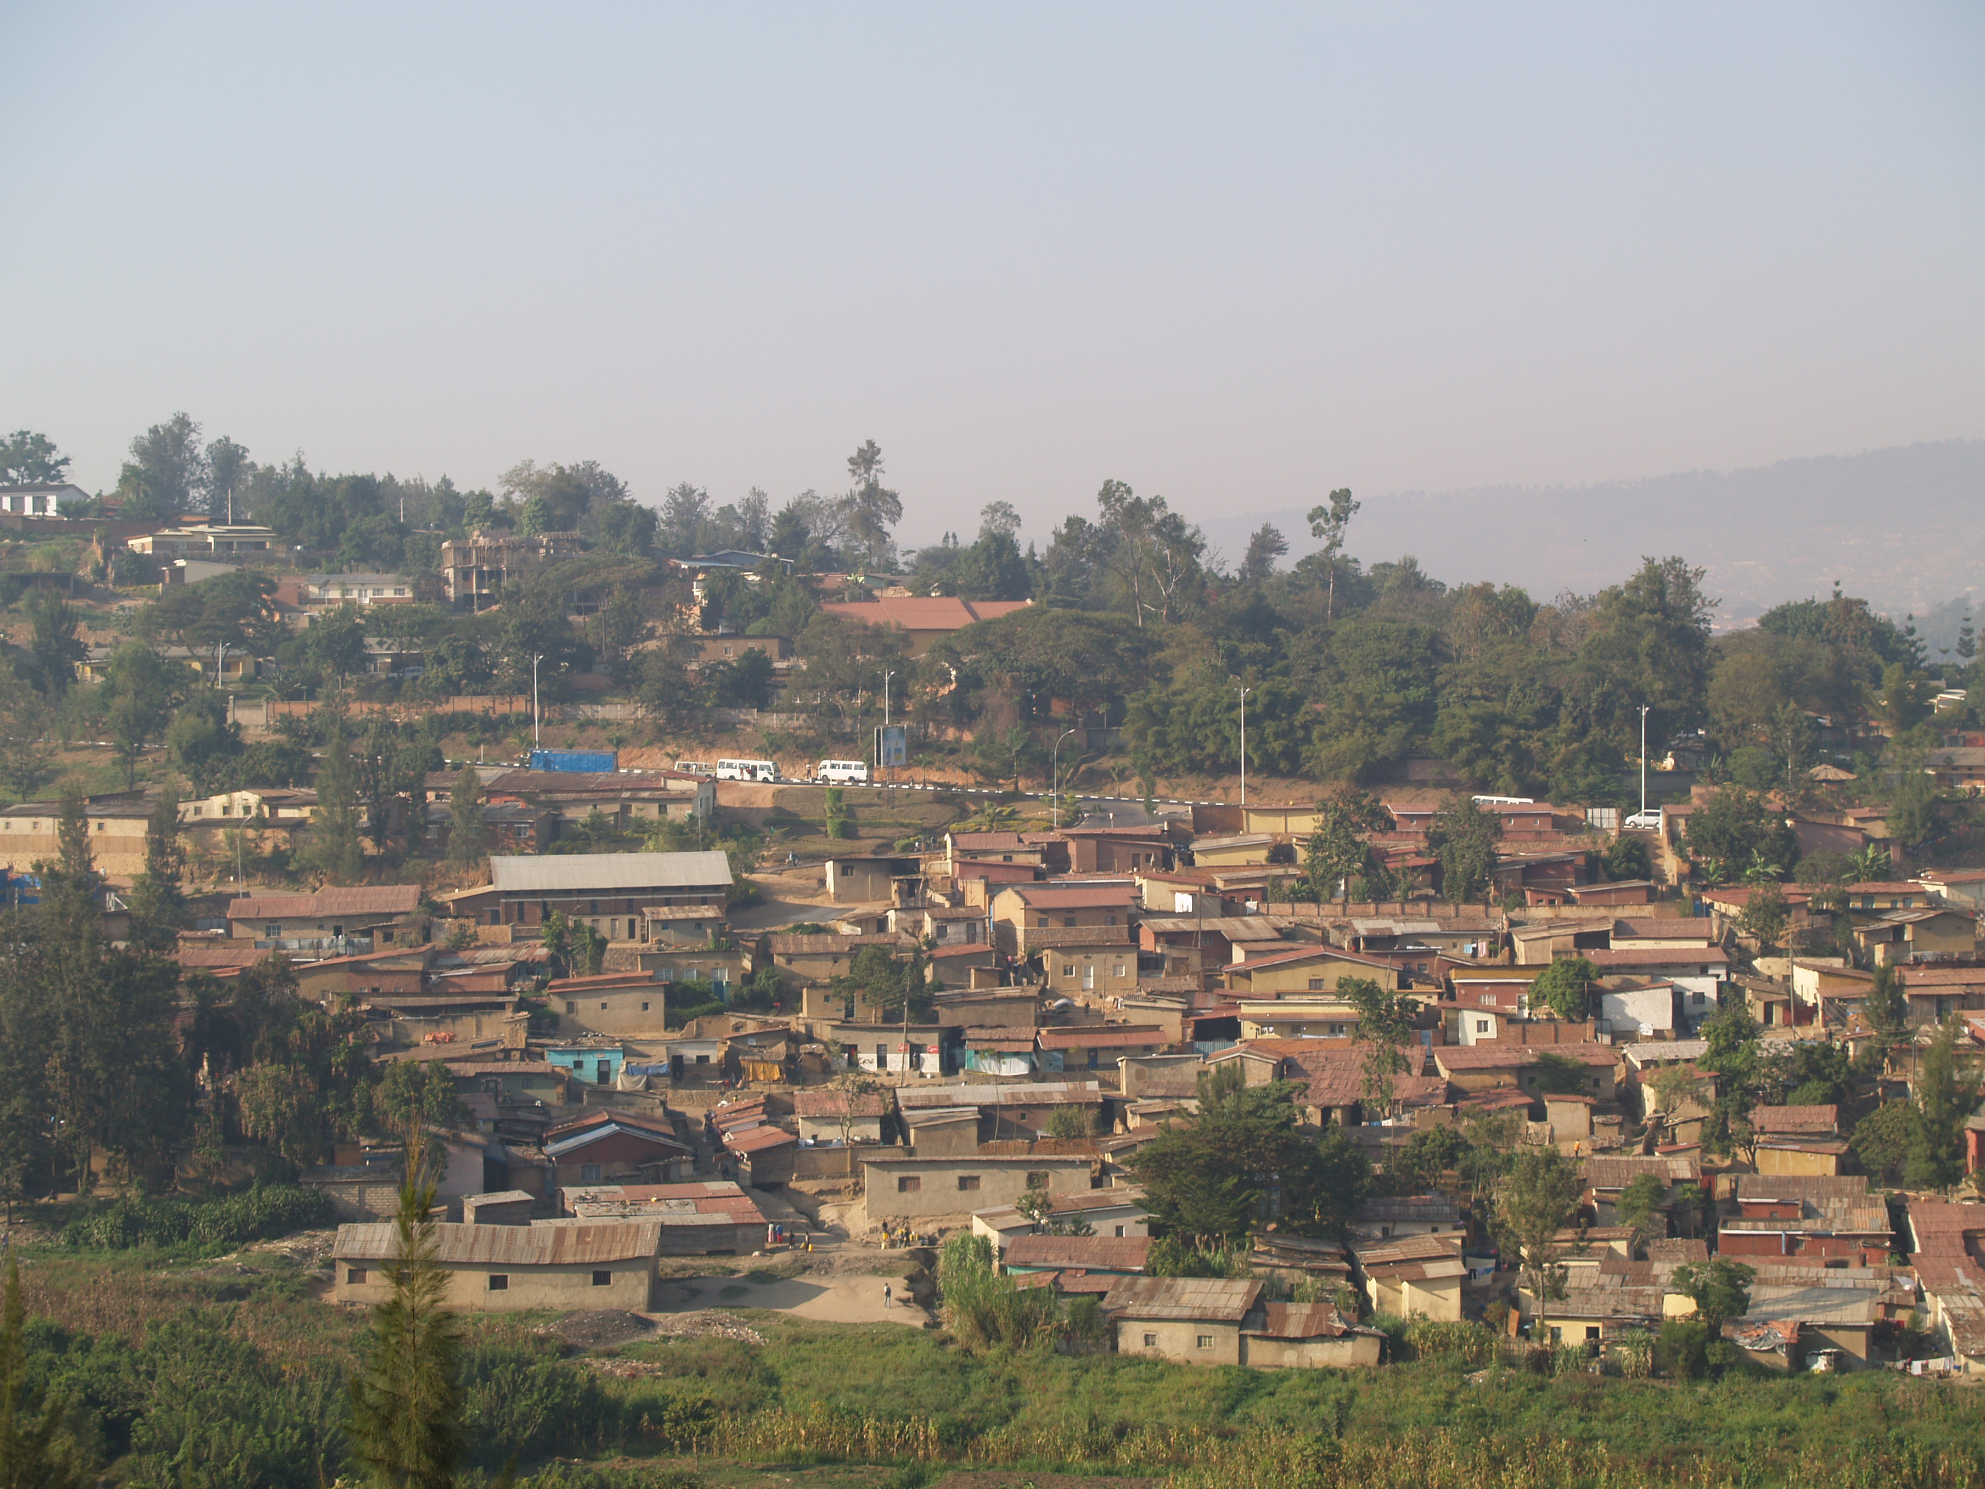
Land of One Thousand Hills
All of Rwanda is very hilly, so much so that the country’s nickname is “Land of One Thousand Hills”.

Slide 4
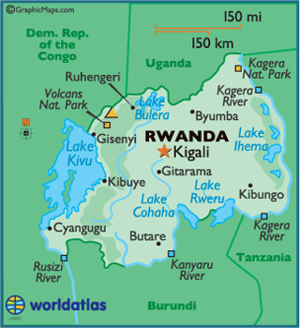
Rwanda
Rwanda is a very small country, about the same size as the state of Maryland (or 1/16 the size of California)!
The city of Ruhengiri is where all the women who spin yarn for KidKnits live.
Though it is very small, Rwanda has 12 million citizens, which makes it the most densely populated African country.

Slide 5
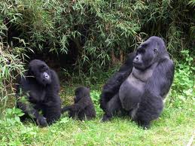
Rwanda Wildlife
Because of its mountainous terrain, wildlife is very different than much of Africa. The Mountain Gorillas are Rwanda’s most famous wildlife.

Slide 6
In Rwanda….
Only 55% of the people of Rwanda have access to clean water. Even fewer have running water in their homes.
There are many children in one classroom—80 or more.
Rwandan children enjoy playing outdoor games, such as tag and hide-and-seek.
Most children wear uniforms to school.
Both girls and boys often shave their heads.
Music and dance are important to the Rwanda people.
Weddings in Rwanda are big family celebrations.
Rwandans will typically eat bananas, corn, potatoes, and beans.
There are five types of bananas in Rwanda, one of which tastes like a potato.
Many schools and communities in Rwanda have organized soccer teams.

